Slide 1
Spark Streaming

Slide 2
Few Concept To Reinforce Before Spark Streaming

Slide 3
Spark Streaming: System Requirements & Installations

Slide 4
Why Spark Streaming?
In order for us to run huge data sets at scale, systems have to be fault tolerant and if they fail, they should recover very quickly.
Not only that, processing has to be super quick – with too much preprocessing and organizing of data to generate the results. That means no stragglers.
Should be able to do this kind of analysis using commercially available over the shelf hardware in a cost effective manner.
None of the existing system meet these!
Hence Spark Streaming.

Slide 5
What is Spark and its Stack
Spark
Is a Cluster Computing Engine – that abstracts away underlying distributed storage and cluster management aspects.
Data Source Agnostic – Hbase, Hive, Cassandra, and any HDFS data source.
External libraries integration – Kafka w Spark Streaming
Spark SQL (Formerly Shark)
GraphX
MLlib
Spark Streaming

Slide 6
Discretized Steams (DStreams)
Dstreams
Is a Sequence of Data arriving over a time scale.
Internally, these are really a sequence of RDDs at each time step.
Dstreams can be created using any of the popular input sources
Flume
Kafka
HDFS
Operations
Dstreams supports 2 operations
Transformation – to convert to another Dstream
Output to write to an external device.
Notes:
Similar to Spark, Spark Streaming also built on RDD and the abstraction layer is called Dstream or Discretized Streams.
Dstream

Slide 7
Batch Processing

Slide 8
Resilient Distributed Dataset (RDD)
What is RDD
Primitive type in Spark – a basic abstraction
Can handle all transformations – map, join, reduce, etc.
3 Types of creation – Parallelizing, external data source (HDFS, etc), transformations on an existing RDDs.
RDDs – Immutable, Distributed Datasets.
Why is it important for Spark and Spark Streaming?
Enables Parallel Operations
Lineage (Fault Tolerance)
Notes:
Immutable – not changeable data sets.

Slide 9
Shared Variables

Slide 10
Spark Streaming: What is it?
Spark
SQL
Spark
Streaming
GraphX
MLlib
Spark
Spark Streaming enables Big Data Stream Processing
Raw Data to Processed Data with Low Latency & Fault Tolerance

Slide 11
Spark Streaming – Typical Applications
Datacenter & DevOp Operations
Web and Mobile App Funnel Metrics
Ad Optimization and Analysis
Pattern recognition(ex – phishing, fraud, etc)
Mobile and IoT Applications.

Slide 12
How does Spark Streaming Work?
Live Streams are chopped into batches of Dstreams which are distributed across many machines.
Spark Streaming also has a mechanism called “Checkpointing” – that saves state periodically to a reliable filesystem (HDFS or S3) – for every 5 to 10 batches – ideal for lost data recovery.

Slide 13
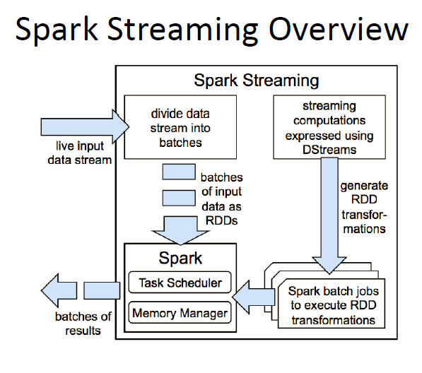
Spark Streaming Overview

Slide 14
Batches and Batch Interval
Streaming computation is really a continuous series of batch computations on small batches of discrete data.
Spark Streaming receives data from various input sources and groups it into small batches.
Batch creations are time interval bound – defined by a parameter called batch interval – which can range from 500 millisecond to many seconds –depending on your application needs.
In between each time interval, any data that comes in will be added to that batch. At the end of the time interval, the batch is closed.
Each input batch is an discrete RDD – is processed to create other RDDs.

Slide 15
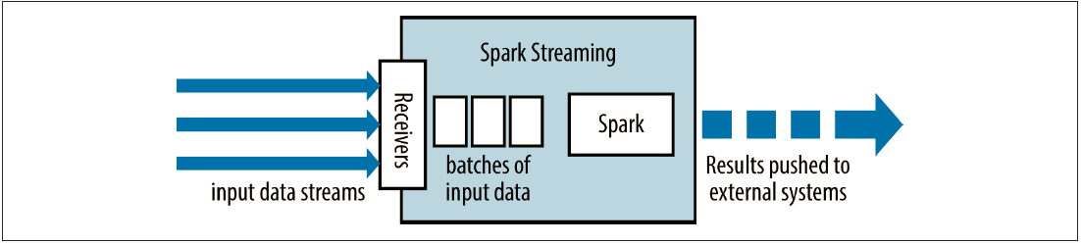
Architecture – High Level
Input Data Stream is converted into discrete batches of input data. Bound by time – batch interval
For each input source, receivers are tasked (tasks) that run to collect the data and save it as RDDs.
Run to Spark Jobs to either transform to other RDDs or ready for external systems
This is called Micro Batch Architecture of Spark Streaming.

Slide 16

Architecture - DStream
Dstreams can be created by either
external input sources such as Kafta, Flume or HDFS
Or when other Dstreams are transformed to new Dstreams.
Output operations are similar to how it is for RDD, except that they are also done in batches.
Dstreams are distributed on multiple machines – even they are all part of same stream.
You operate on Dstream as if they are clusters.
Batch processing and streaming process are done in parallel.

Slide 17
Architecture - Receivers
Receivers are tasks running in application’s executors.
They collect the data and convert it into RDDs
For Fault Tolerance, they also replicate the input data to other executors. Received data is replicated across two nodes, so can tolerate single worker failure.

Slide 18
Network Receiver
Network Receivers definition is very simple –
what to do when you start the receiver,
what to do when you stop the receiver.

Slide 19
Architecture - Transformations
There 2 types of transformations
Stateless
Stateful
Stateless means – the transformation on a particular batch doesn’t depend on the previous batch. Common RDD transformations such as Map, Filter, countByValue, reduceByKey, etc. Example, filter a particular word/string a stream of text.
Stateful Transformation – uses the data or results from previous batches to compute the results of current batch. These are transformations based on Sliding windows and on tracking state across time. Example operations include window, countByValueAndWindow, etc. Example use cases – if we want to calculate % of price increase per trade for a given stock on NASDAQ, etc.

Slide 20
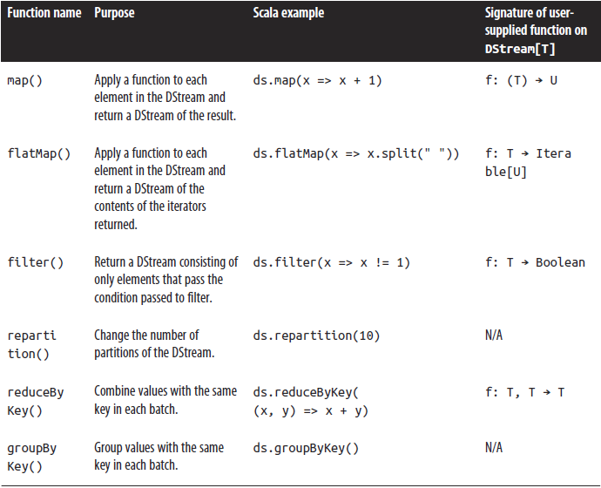
Dstream Stateless Transformations (some functions)

Slide 21
Stateless Transformations Over Data from Multiple DStream
Stateless transformations can also combine data from multiple Dstreams within each time step.
Dstreams have same join-related transformation as RDDs.
Example operations are
cogroup(),
join (),
leftOuterJoin() are some of the examples.
Outputs of two Dstreams using union() operator similar to how you do in core Spark or using StreamingContext.union() for multiple streams.

Slide 22
Advanced Stateless Transformations
Joining two Dstreams
val ipBytesDStream =accessLogsDStream.map(entry => (entry.getIpAddress(), entry.getContentSize()))
val ipBytesSumDStream =ipBytesDStream.reduceByKey((x, y) => x + y)
val ipBytesRequestCountDStream =ipCountsDStream.join(ipBytesSumDStream)
Use join to join the Dstreams from map and reduceByKey transformations.
Transform() is an advanced operator that lets you operate directly on the RDDs inside them – between two different RDDs within a DStreams
val outlierDStream = accessLogsDStream.transform { rdd =>extractOutliers(rdd)

Slide 23
Stateful Transformations
These operations track data across time – make use of previous data to generate or run current transformations.
There are two main types of windowed operations
Sliding Window
updateStatebyKey
Stateful transformations require “Checkpointing” for fault tolerance.
For each windowed operation, you need 2 parameters
WindowDuration
SlidingDuration
Both the above parameters are multiples of batch interval. So, a WindowDuration could be 5 BatchIntervals.
SlidingDuration defaults to BatchInterval sets how frequently the new Dstream computes results.

Slide 24
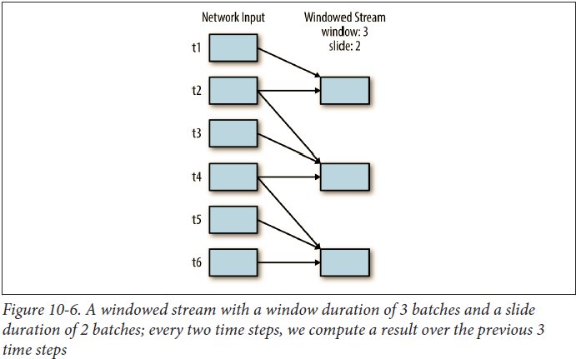
Windowed Stream with a window duration example

Slide 25
Windowed Transformations
Windowed operations compute results across a longer time period than the StreamingContext’s batch interval.
All Windowed operations need two parameters – window duration and sliding duration – both of which must be a multiple of the StreamingContext’s batch interval.
Sliding Duration defaults to Batch interval.
Example – If we had a Dstream with a batch interval of 20 seconds and wanted to compute window only every 4th batch, then the sliding interval will be 80 seconds.

Slide 26
Window () to count data over a window in Scala
val accessLogsWindow = accessLogsDStream.window(Seconds(30), Seconds(10))
val windowCounts = accessLogsWindow.count()
Other operators include
reduceByWindow() -
reduceByKeyAndWindow () –
TBD

Slide 27
Data Counting Operations in Windows
countByWindow ()
Returns number of elements in each Window
countByValueAndWindow()
Returns a Dstream with counts for each value.
Few Examples
val ipDStream = accessLogsDStream.map{entry => entry.getIpAddress()}
val ipAddressRequestCount = ipDStream.countByValueAndWindow(Seconds(30), Seconds(10))
val requestCount = accessLogsDStream.countByWindow(Seconds(30), Seconds(10))

Slide 28
Architecture – Fault Tolerance
Raw input data is replicated in memory. It is a RDD replicated in memory – not the transformed RDDs.
Sparks memory manager called Block memory keeps the replicated data as long as its required.
RDDs remember the operations that created them.
Data lost due to worker failure is recomputed using the raw input data – hence all transformed data is fault-tolerant. Hence Checkpointing is very critical for being fault tolerant.

Slide 29
Output Operations
Print() grabs 1st 10 elements from each batch of the Dstream and prints the results.
Save() saves elements in a Dstream in a separate directory.
ipAddressRequestCount.saveAsTextFiles("outputDir", "txt")
SaveAsHadoopFiles ()
forEachRDD()
ipAddressRequestCount.foreachRDD { rdd =>rdd.foreachPartition { partition =>// Open connection to storage system (e.g. a database connection) partition.foreach { item =>}}}

Slide 30
Input Sources
Popular ones
Sockets
Apache Kafka
HDFS
Apache Flume
Push based receiver
Pull based receiver
Twitter
You can include additional receivers by adding the Maven artifact spart-streaming-[projectname]_2.10
Core Sources
Stream of Files
Akka Actor Stream

Slide 31
Dstream Graph

Slide 32
RDD Graph

Slide 33
Dstream Graph → RDD Graph → Spark Jobs

Slide 34
How to build and run Spark Streaming Apps?
Streaming apps are best run using Maven (for Scala as well) or SBT
Spark Streaming is shipped as a standalone Maven Module and has additional imports.

Slide 35
Streaming Imports
Even though Spark Streaming is part of Spark, it comes as a separate artifact.
Need to add following Imports (Scala Example).
import org.apache.spark.streaming.StreamingContext
import org.apache.spark.streaming.StreamingContext._
import org.apache.spark.streaming.dstream.DStream
import org.apache.spark.streaming.Duration
import org.apache.spark.streaming.Seconds

Slide 36
Initializing Spark Streaming Application
val sst = new StreamingContext(SparkConf, batchDuration)
StreamingContext
is the main entry point for Streaming Functionality.
Not only that, it also sets up the SparkContext – the Driver program that access Spark. SparkContext is the connection to the Computing Cluster. Once you have SparkContext, you can use it to build RDD.
It provides methods used to create Dstream from various input sources such as Kafka, the like.
SparkConf is the configuration for a spark app – name/value pair.
batchDuration is the duration or time interval to process new data

Slide 37
Simple Socket Text-Stream Receiver
A simple socketTextStream receiver to create a DStream from a text received over a port on your machine can be
val lines = ssc.socketTextStream("localhost", port)
Localhost or IP Address
Now if you want to print lines that have a particular “string” of text in the DStream, you would
val stringCount = lines.filter(_.contains("string"))
Each record in stringCount is a line of text with "string"
stringCount.print()

Slide 38
Instead if you want to count # of words
Val words=lines.flatMap(_.split(“”))
flatMap is a one to many (stateless transformations) Dstream operator that creates a new Dstream by generating multiple new records from each record in the src Dstream.
Val wordStream=words.map(word=> (word, 1))
Map is another stateless transformation Dsream operator that pass each element in the src Dstream through a function & transforms individual Dstream within each time step.
Val count = wordStream.reduceByKey(_+_)
reduceByKey is another Dstream transformation to transform within each time step.
Note that each of the DSTream consists of many RDD, and each of the above transformations apply separately to individual RDDs.

Slide 39
Now lets start the Streaming
So far we have put all the basic wiring for spark streaming. Now we need to start this computation
You run start() command on the StreamingContext to start the computation
Ssc.start()
Ssc.awaitfortermination()
Note – that StreamingContext can only be started once and that is the reason we wait until all the wiring is done before kicking off the start command.

Slide 40
Running the Streaming App
Launch Spark Shell
At the prompt
Spark-submit –class YourApp\$ASSEMBLY_JAR local[4]
Nc localhost 7777
<type text for streaming>
Note – windows users can use ncat instead of nc

Slide 41
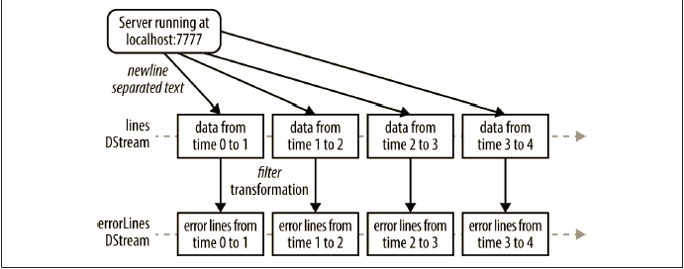
Previous Code Example (Lines w String)

Slide 42
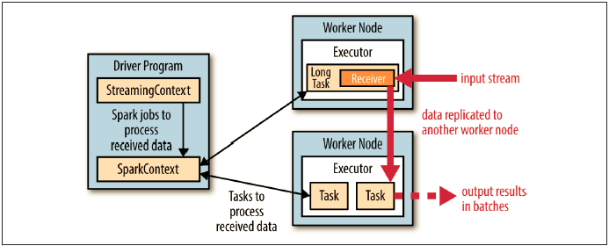
Architectural View of Spark Streaming within Spark

Slide 43
24/7 Operations
Spark Streaming can be run in 24/7 mode even if a worker or drivers fail.
In order for Streaming to run 24/7, for setting up Checkpointing, one needs reliable storage system such as S3 or HDFS
ssc.checkpoint("hdfs://...")
Lack of Checkpointing throws a warning/error even in local setup.

Slide 44
Checkpointing
Is a way to save state periodically to a reliable filesystem – HDFS or S3
Using lineage, recomputation could take a long time for data that has been built up since the beginning of the program.
One could set up checkpointing every 5 to 10 batches of data.
So, when recovering lost data, Spark Streaming needs only to go back to the last checkpoint.
You can run checkpoint() by
Ssc.checkpoint(local path or “HDFS://..”)

Slide 45
Driver Failure
To run StreamingContext on a failed driver can be
val ssc = StreamingContext.getOrCreate(checkpointDir, createStreamingContext _)
You need restart the driver if it crashes.

Slide 46
Worker Fault Tolerance
All RDDs created through transformations of this replicated input data are tolerant to failure of a worker node, as the RDD lineage allows the system to recompute the lost data all the way from the surviving replica of the input data.

Slide 47
Receiver Fault Tolerance

Slide 48
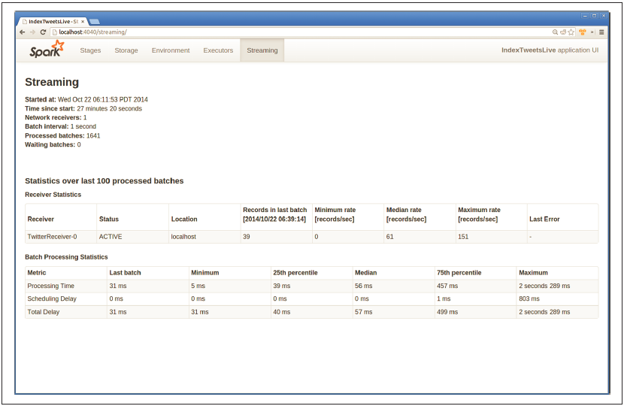
Streaming UI

Slide 49
Combine Streaming with GraphX & MLlib

Slide 51
Looking up Streaming Data (Using SQL)

Slide 52
Lab 1
Find a particular String of Characters in a Stream of Text in Real time.

Slide 53
Lab 2
Running count of Pageview events by URL

Slide 54
Lab 3
Lab without any transformation
Lab with transformation (map, filter, flatMap, MapPartitions)

